Slide 1

KUALA LUMPUR
29 DEC 2023
PROCESS INJECTION 101 :
injecting processes for fun and profit

Slide 2

what is process injection?
a technique used by adversaries to execute arbitrary code in the address space of a separate live process
evade detection (like a true hackerman)
privilege escalation
persistence
steal credentials
e.g : BlackEnergy, Conti, Emotet

Slide 3
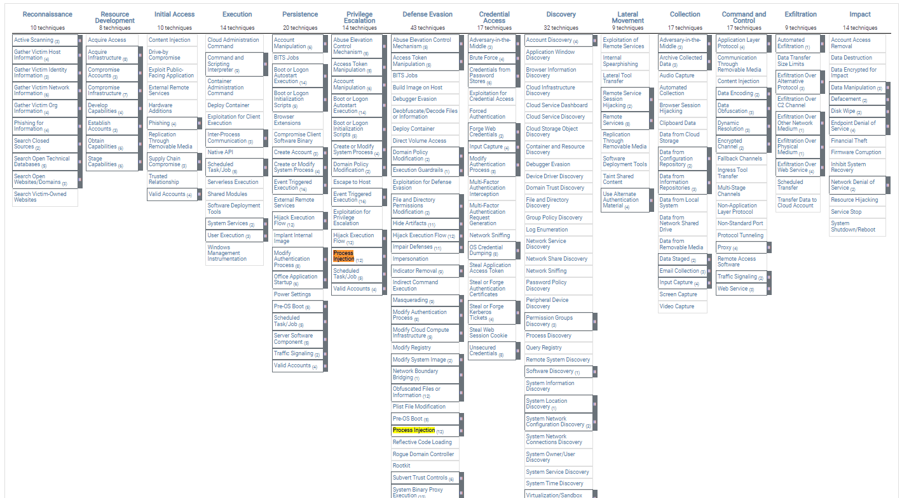

MITRE ATT&CK Framework

Slide 4
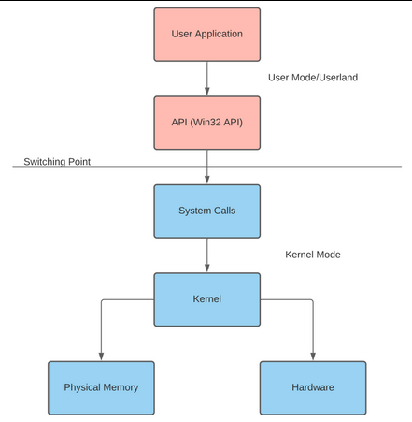
intro - what is Windows API?
Application Programming Interface = code required to react with OS – stored in .DLL
.h VS .dll
header (contains declarations of functions and external variables) – eg : Windows.h
DLL = Dynamic Link Library – not linked to program’s executable file – stub used to load the library at the runtime – eg: comdlg32.dll

Slide 5
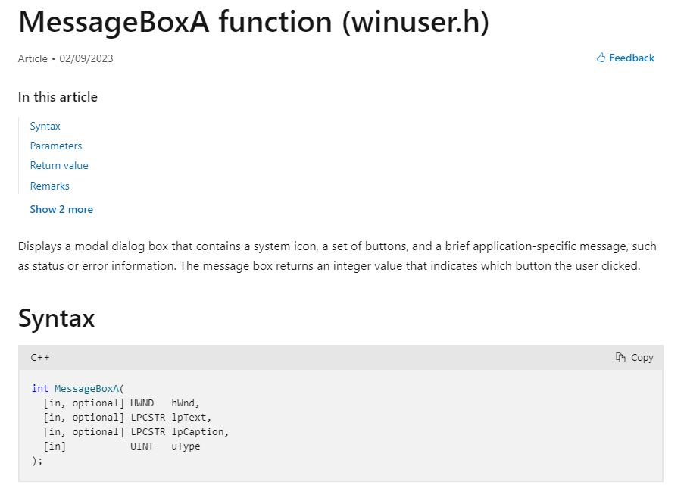
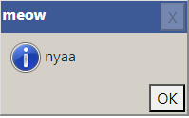
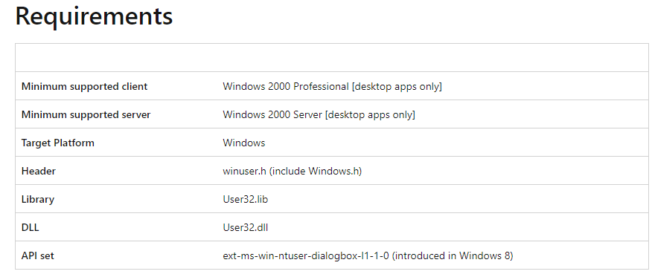
example of Windows API

Slide 6
basics of process injection
get or create process
injected data
transfer to process
execution

Slide 7
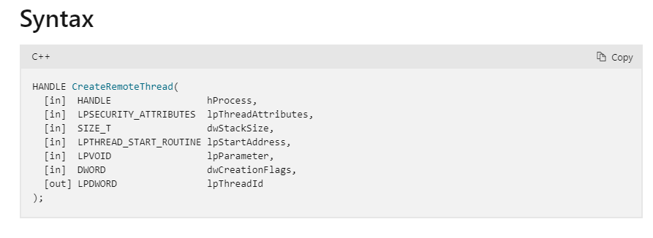
get / create process
obtain handle (open / create a process)
e.g : CreateRemoteThread

Slide 8
injected data
types of data that can be injected are;
section
code
process
DLL

Slide 9
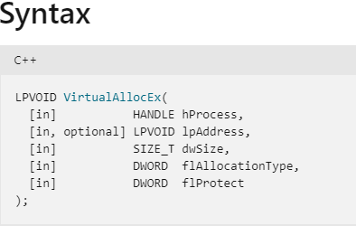
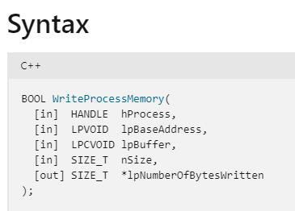
transfer to process
ways to transfer data to target process
e.g : VirtualAllocEx,WriteProcessMemory

Slide 10
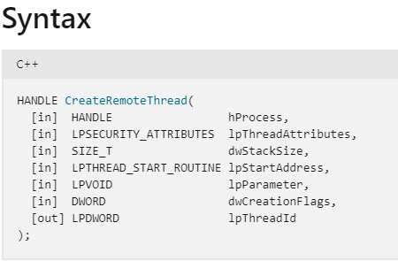
execution
start the execution of the injected section
e.g : CreateRemoteThread

Slide 11
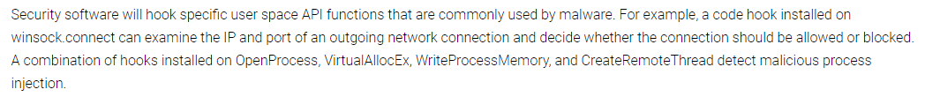
proof of concept : vanilla process injection
the most common method of process injection (CreateRemoteThread, VirtualAllocEx , etc.) – will normally get caught by AV/EDR – API hooking
encrypted payload is stored on disk – help to bypass on-disk detection

Slide 12
proof of concept
demo

Slide 13
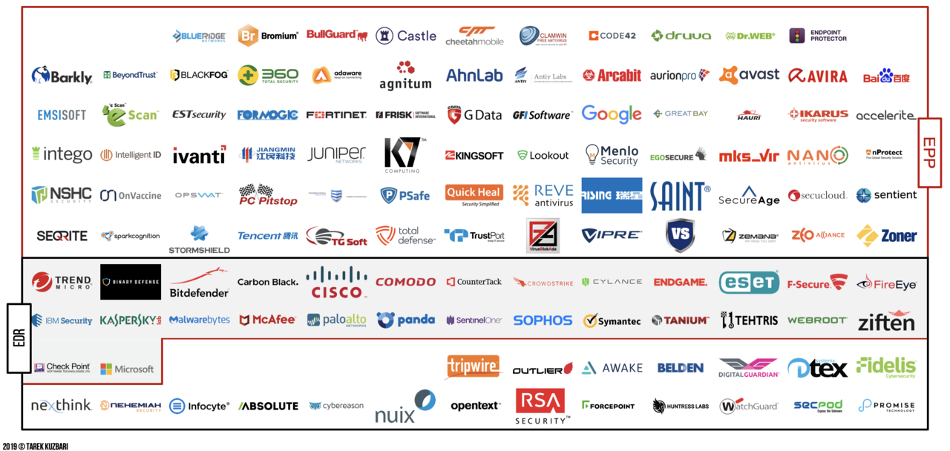
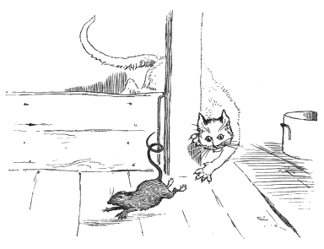

some variations
journey to bypass all detections (like a true hackerman)

Slide 14
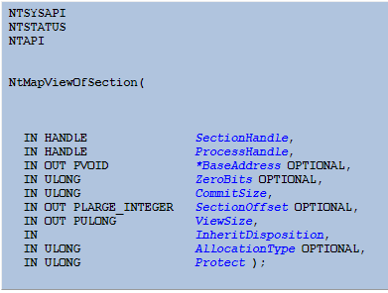
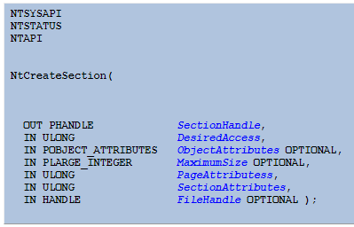
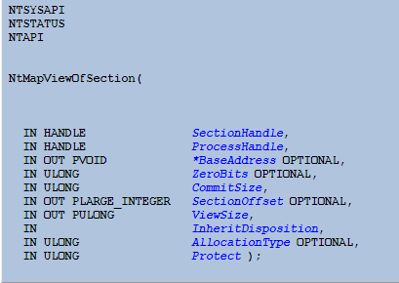
variations - transfer to process
NtUnMapViewOfSection, NtCreateSection, NtMapViewOfSection

Slide 15
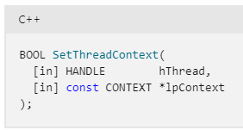
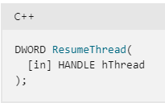
variations - execution
start the execution of the injected section
e.g : SetThreadContext , ResumeThread

Slide 16
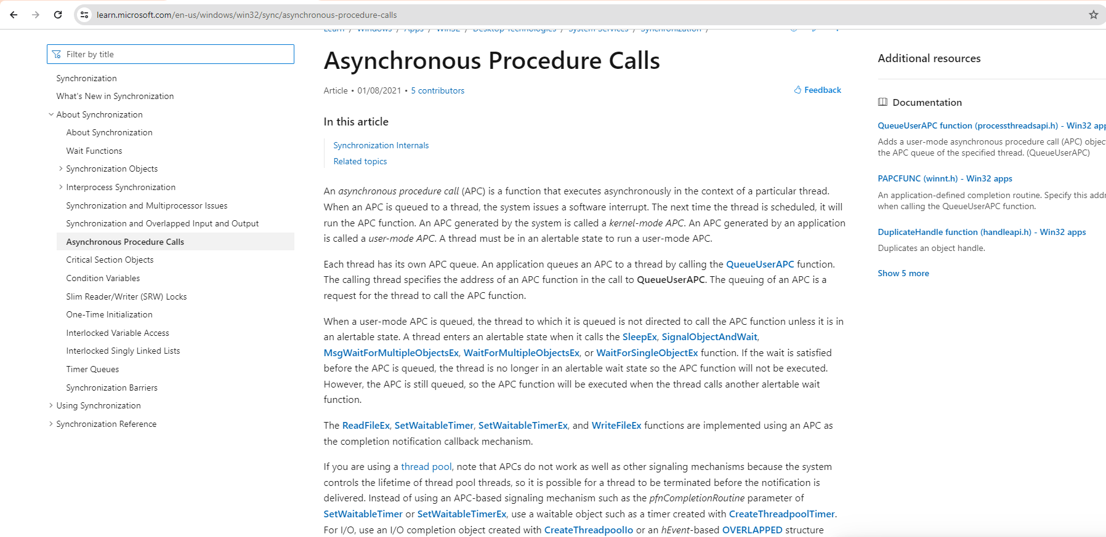

variations – QueueUserAPC
Asynchronous Procedure Call
what is APC?

Slide 17
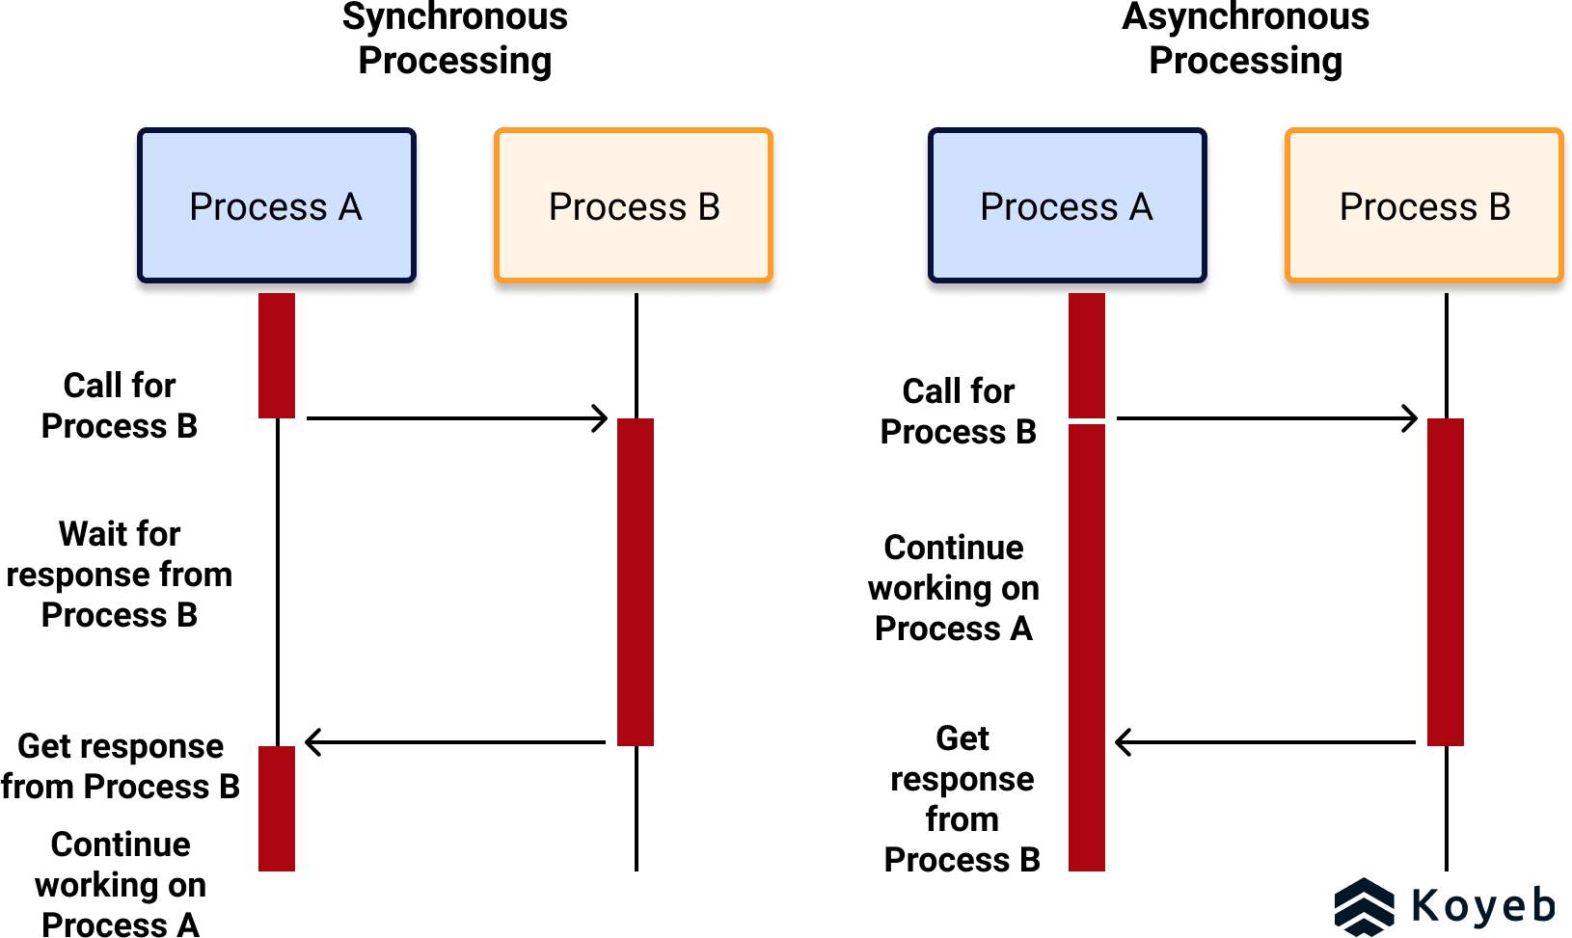
variations – QueueUserAPC
Asynchronous Procedure Call
Function -> executes asynchronously -> in the context of a thread (a thread is a unit of execution within a process)
Each thread has its own APC queue
APC generated by application is called user-mode APC
A thread must be in alertable state to run a user-mode APC

Slide 18


thread
thread
thread
thread
thread
thread
thread
thread
thread
thread
thread
thread
thread
thread
thread
thread
thread
thread
thread
thread
thread
thread
thread
thread
thread
thread
thread
thread
thread
thread
thread
thread
Thread vs Process
?

Slide 19
variations – QueueUserAPC
demo
spoiler alert – will get caught by AV/EDR

Slide 20
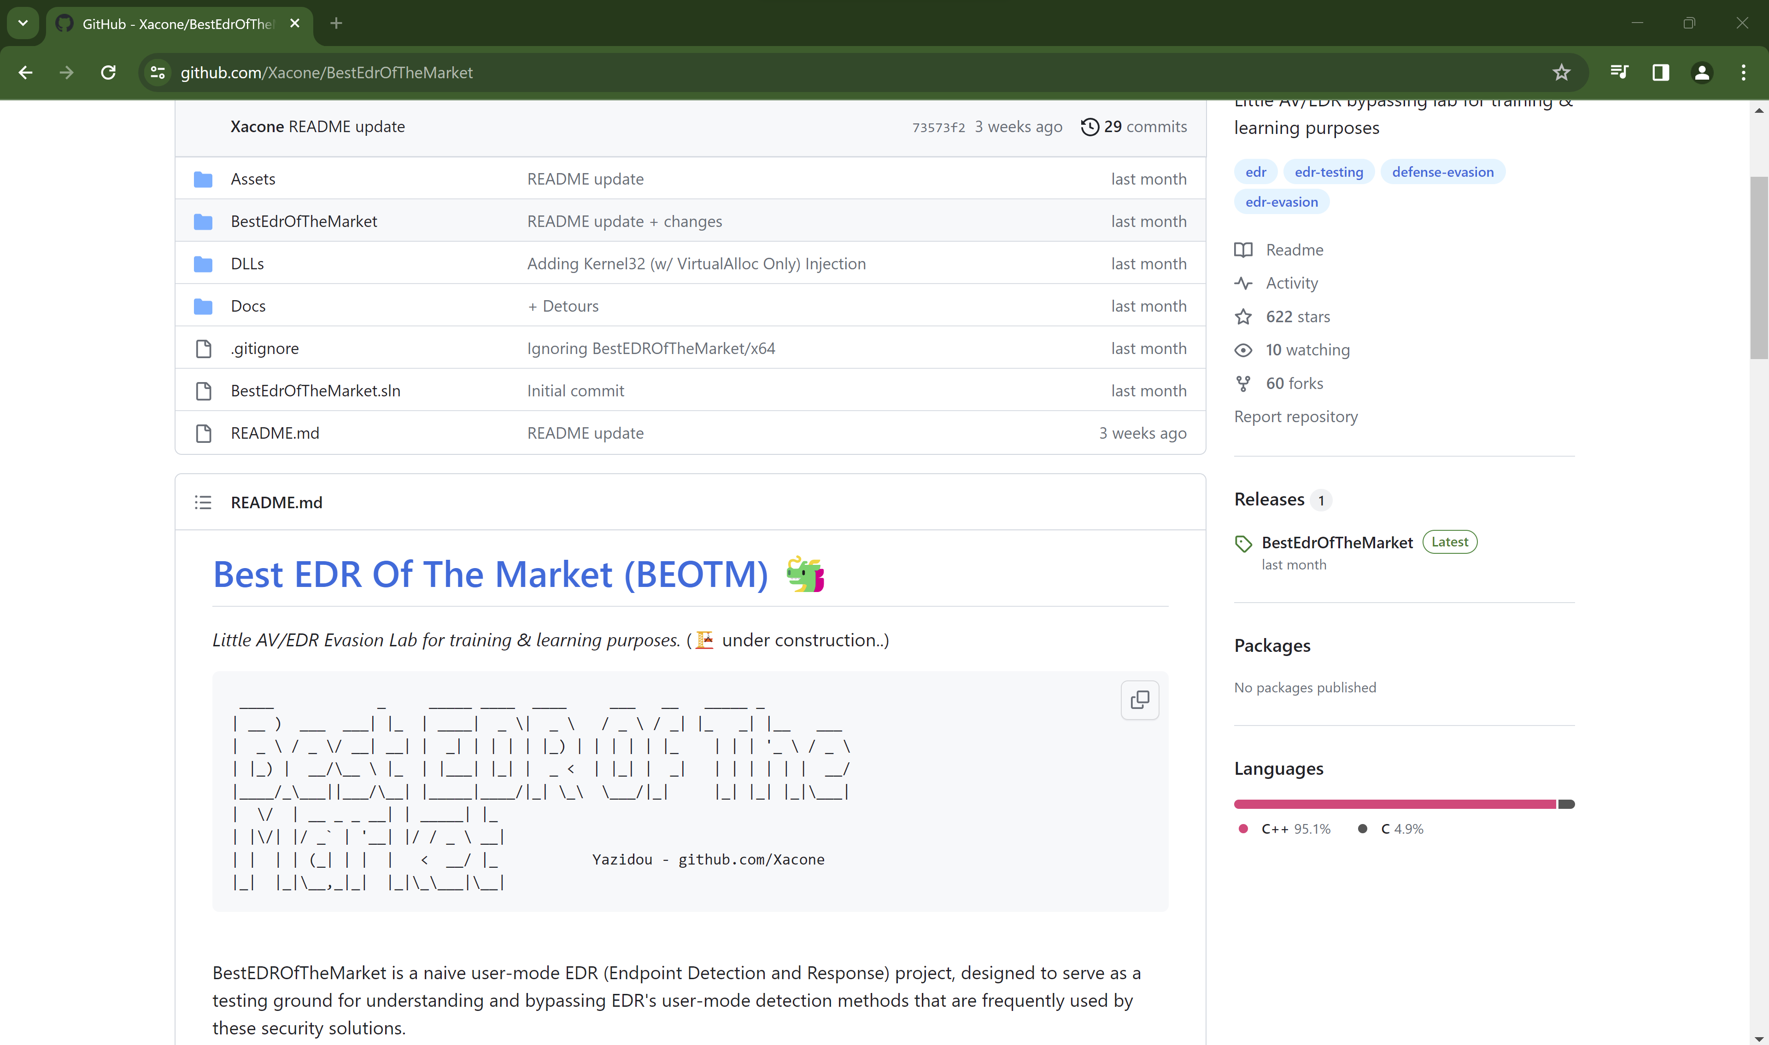
Training Grounds - BEOTM

Slide 21


BEOTM BYPASS LET’S GOOOOOOO…. – Based on true story
Use different technique? – Doppelgänging? Early bird APC Queue? Direct/Indirect Syscall? P/Invoke? Proc Memory? D/Invoke? API Hashing? DLL Unhooking? ProcessDynamicCodePolicy? EWM injection? AtomBombing? VDSO Hijacking? ListPlanting? Ptrace Syscalls? Inline hooking? Thread Local Storage (TLS) Injection? Hell’s Gate? Kernel Driver Injection? Halo’s Gate? Tartarus Gate? PoolParty? TxF Doppelgänging? Fork Bombing? Import Table Hooking? Kernel Code Patching + APC ? etc…

Slide 22
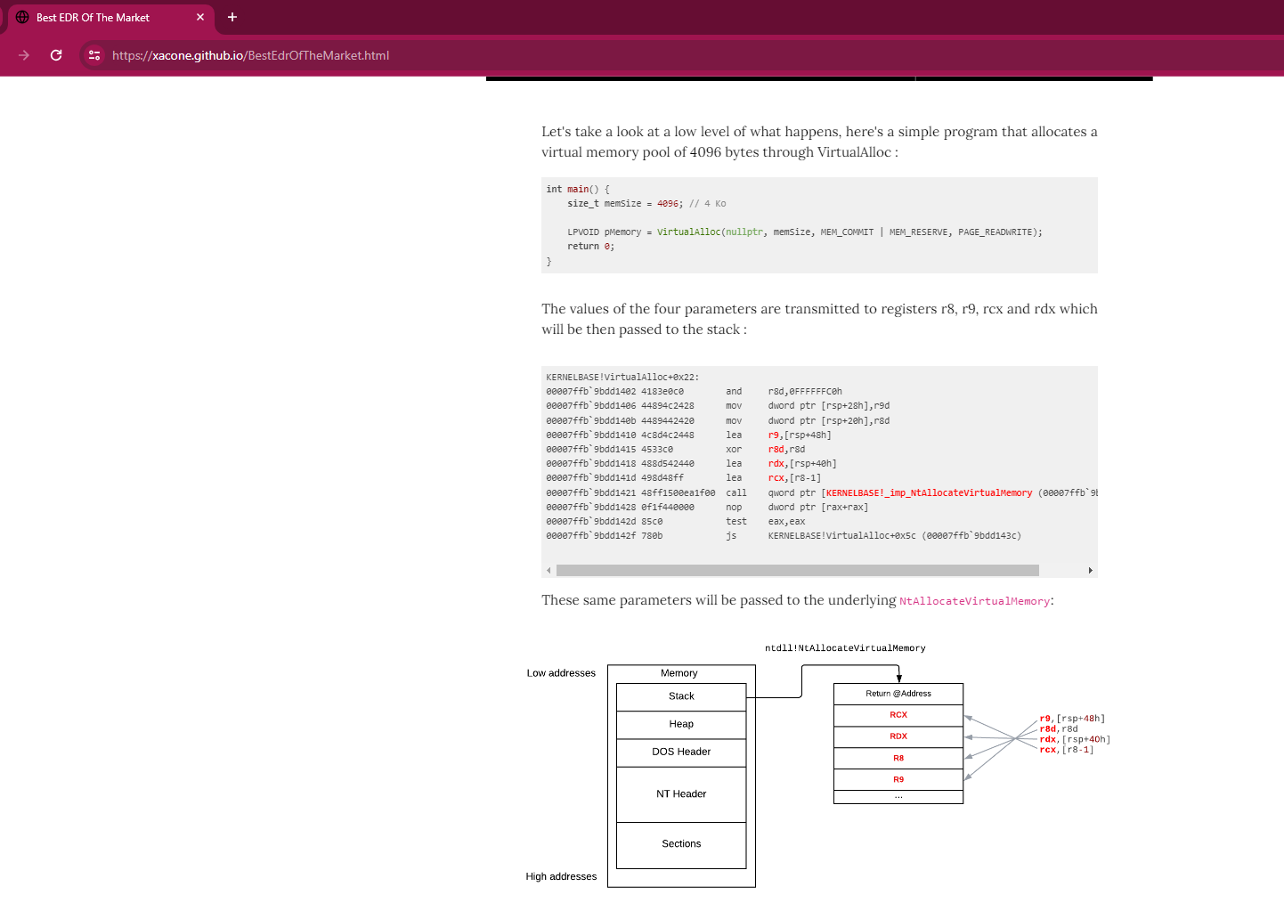
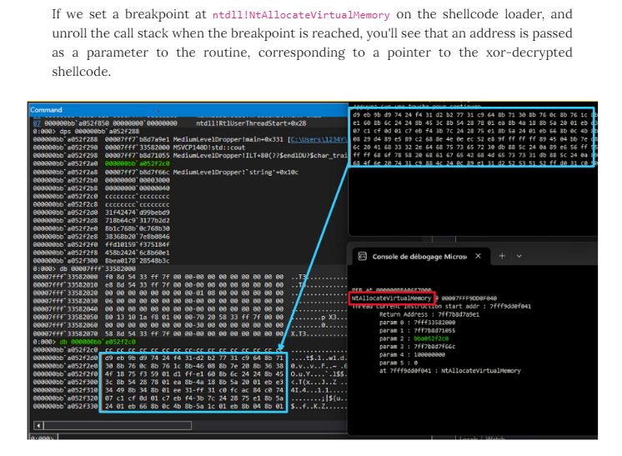

instead of jumping into the rabbit hole, why don’t we understand how this EDR works?
how?
READ THE .. MANUAL!
For example, we want to understand how threads call stack monitoring works in BEOTM;
Continuous monitoring of the RIP instruction register for each thread.
Pause thread if RIP points to an exported routine/function from a DLL or a specified area and check if the routine/function is listed in TriggeringFunctions.json for monitoring.
Unwind the thread's call stack.
Analyze parameters of stacked routines.
Stop the process and issue an alert if a parameter's byte sequence matches a pattern in YaroRules.json.

Slide 23
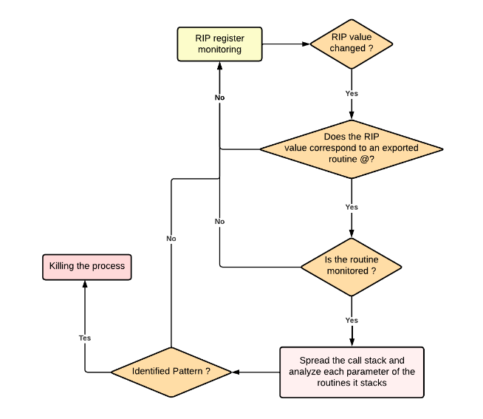
Conditional diagram on how threads call stack monitoring works on BEOTM :

Slide 24
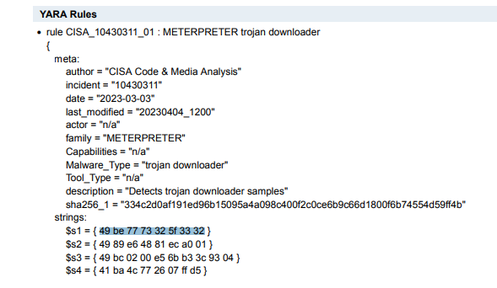
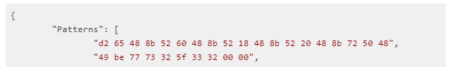
What is in TriggeringFunctions.json?
Contains functions that are hooked by the EDR.
High likely contains our vanilla process injection functions.
What is in YaroRules.json?
Contains pattern for the EDR to identify
contains default pattern for reverse_tcp shellcode generated by Metasploit

Slide 25
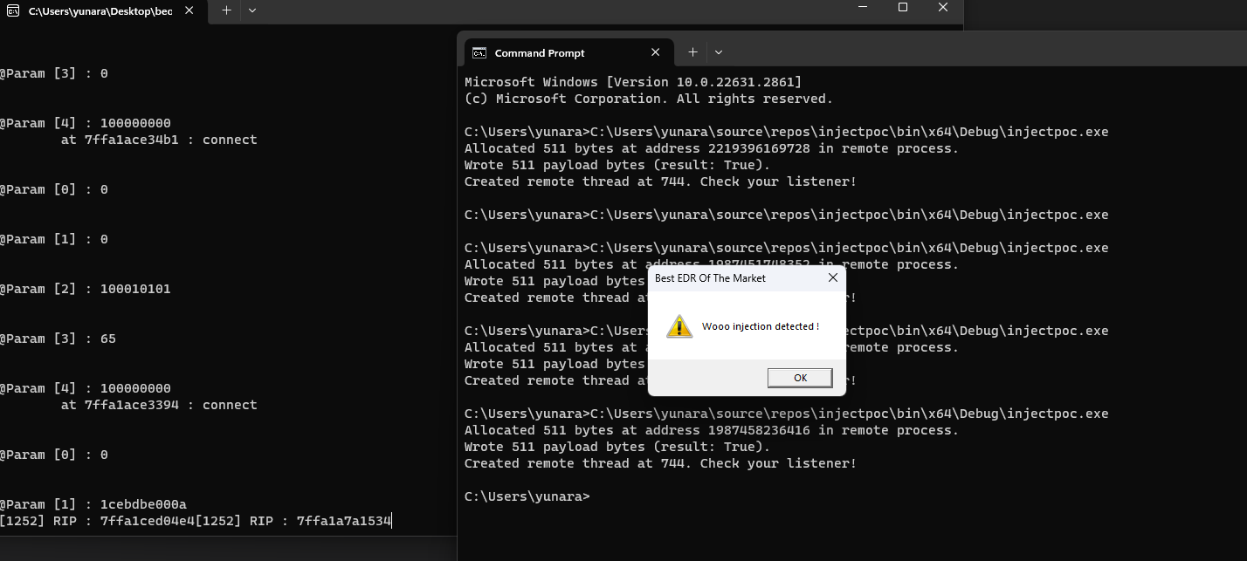
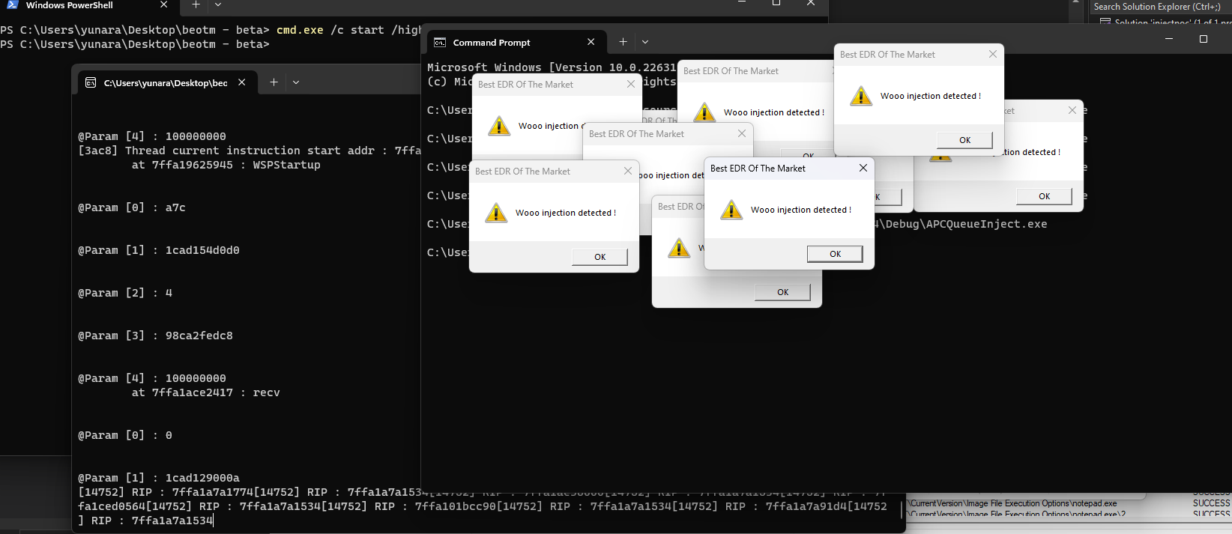
Vanilla Process Injection VS BEOTM
APC Queue VS BEOTM

Slide 26


Bypass BEOTM Threads Call Stack Monitoring
Use custom/different shellcode
Not generated by Metasploit
No signature/pattern in YaroRules.json
Maintain API calls (Vanilla/APC)
Bypassed!
Profit!!

Slide 27
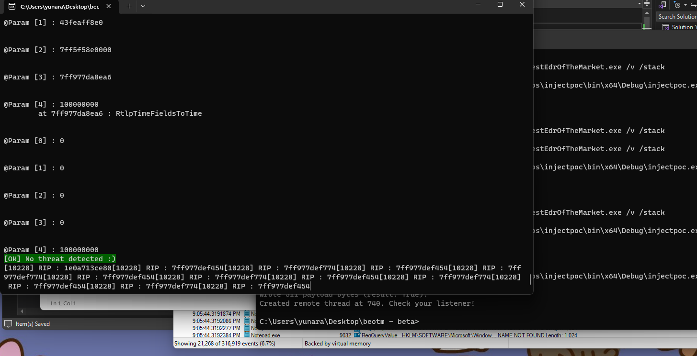


Slide 28

What if I still want to execute my meterpreter shellcode and ignore the rules of the universe (YaroRules.json)?
Mr. Giga Chad

Slide 29
BEOTM BYPASS LET’S GOOOOOOO…. – Based on true story
Use different technique? – Doppelgänging? Early bird APC Queue? Direct/Indirect Syscall? P/Invoke? Proc Memory? D/Invoke? API Hashing? DLL Unhooking? ProcessDynamicCodePolicy? EWM injection? AtomBombing? VDSO Hijacking? ListPlanting? Ptrace Syscalls? Inline hooking? Thread Local Storage (TLS) Injection? Hell’s Gate? Kernel Driver Injection? Halo’s Gate? Tartarus Gate? PoolParty? TxF Doppelgänging? Fork Bombing? Import Table Hooking? Kernel Code Patching + APC ? etc…

Slide 30
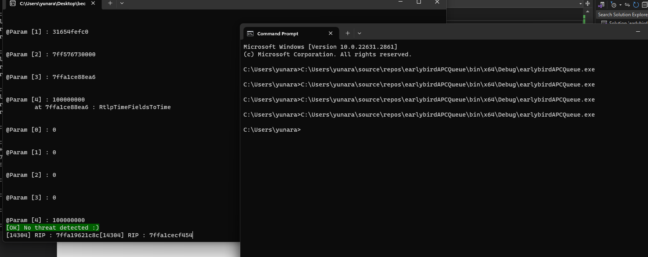
Some homework for you guys…

Slide 31

End?
Take the blue pill and stop here or take the red pill and explore all the possibilities…
Follow me on github : @yunaranyancat (plssss..)
Open for collaboration/jobs : mzulfiqar.wardi@gmail.com

